Slide 1

Northwind Traders Capstone Dashboard
Power BI + Excel + Data Analysis Project
Prepared By: Boddu Sai Akhil
Date: 30-08-2025

Slide 2
Problem Statement
The objective is to build a visually appealing and interactive dashboard for Northwind Traders.
Clear Communication
Actionable Insights
Communicate key performance metrics clearly.
Provide insights into customer behavior, sales patterns, employee performance, and suppliers.
Data-Driven Decisions
Operational Improvement
Enable stakeholders to make data-driven decisions.
Improve operational efficiency and business growth.

Slide 3
Dataset Overview
The project utilizes the Northwind Database, a sample business dataset.
Core Information
Key Tables
Customers
Customers: CustomerID (Primary Key), CompanyName, ContactName, ContactTitle, Address, City, Region, PostalCode, Country, Phone, Fax, Image, ImageThumbnail
Orders
Products
Orders: OrderID (Primary Key), CustomerID (Foreign Key → Customers), EmployeeID (Foreign Key → Employees), OrderDate, RequiredDate, ShippedDate, ShipVia (Foreign Key → Shippers), Freight, ShipName, ShipAddress, ShipCity, ShipRegion, ShipPostalCode, ShipCountry
Employees
Suppliers
Order_Details: OrderID (Composite Primary Key, Foreign Key → Orders), ProductID (Composite Primary Key, Foreign Key → Products), UnitPrice, Quantity, Discount
Shippers
Categories
Products: ProductID (Primary Key), ProductName, SupplierID (Foreign Key → Suppliers), CategoryID (Foreign Key → Categories), QuantityPerUnit, UnitPrice, UnitsInStock, UnitsOnOrder, ReorderLevel, Discontinued
Suppliers: SupplierID (Primary Key), CompanyName, ContactName, ContactTitle, Address, City, Region, PostalCode, Country, Phone, Fax, HomePage
Employees: EmployeeID (Primary Key), LastName, FirstName, Title, TitleOfCourtesy, BirthDate, HireDate, Address, City, Region, PostalCode, Country, HomePhone, Extension, Photo, Notes, ReportsTo (Foreign Key → Employees.EmployeeID, self-join), PhotoPath
Shippers: ShipperID (Primary Key), CompanyName, Phone
Categories: CategoryID (Primary Key), CategoryName, Description, Picture

Slide 4
Approach & Methodology
01
02
03
Data Extraction
Data Transformation
DAX Measures
From Northwind dataset.
Cleaning and transformation.
Build measures in Power BI.
04
05
06
Dashboard Creation
Visualization
Documentation
In both Excel & Power BI.
KPIs, trends, and insights.
Document findings.
07
Presentation
Summarize work professionally.

Slide 5
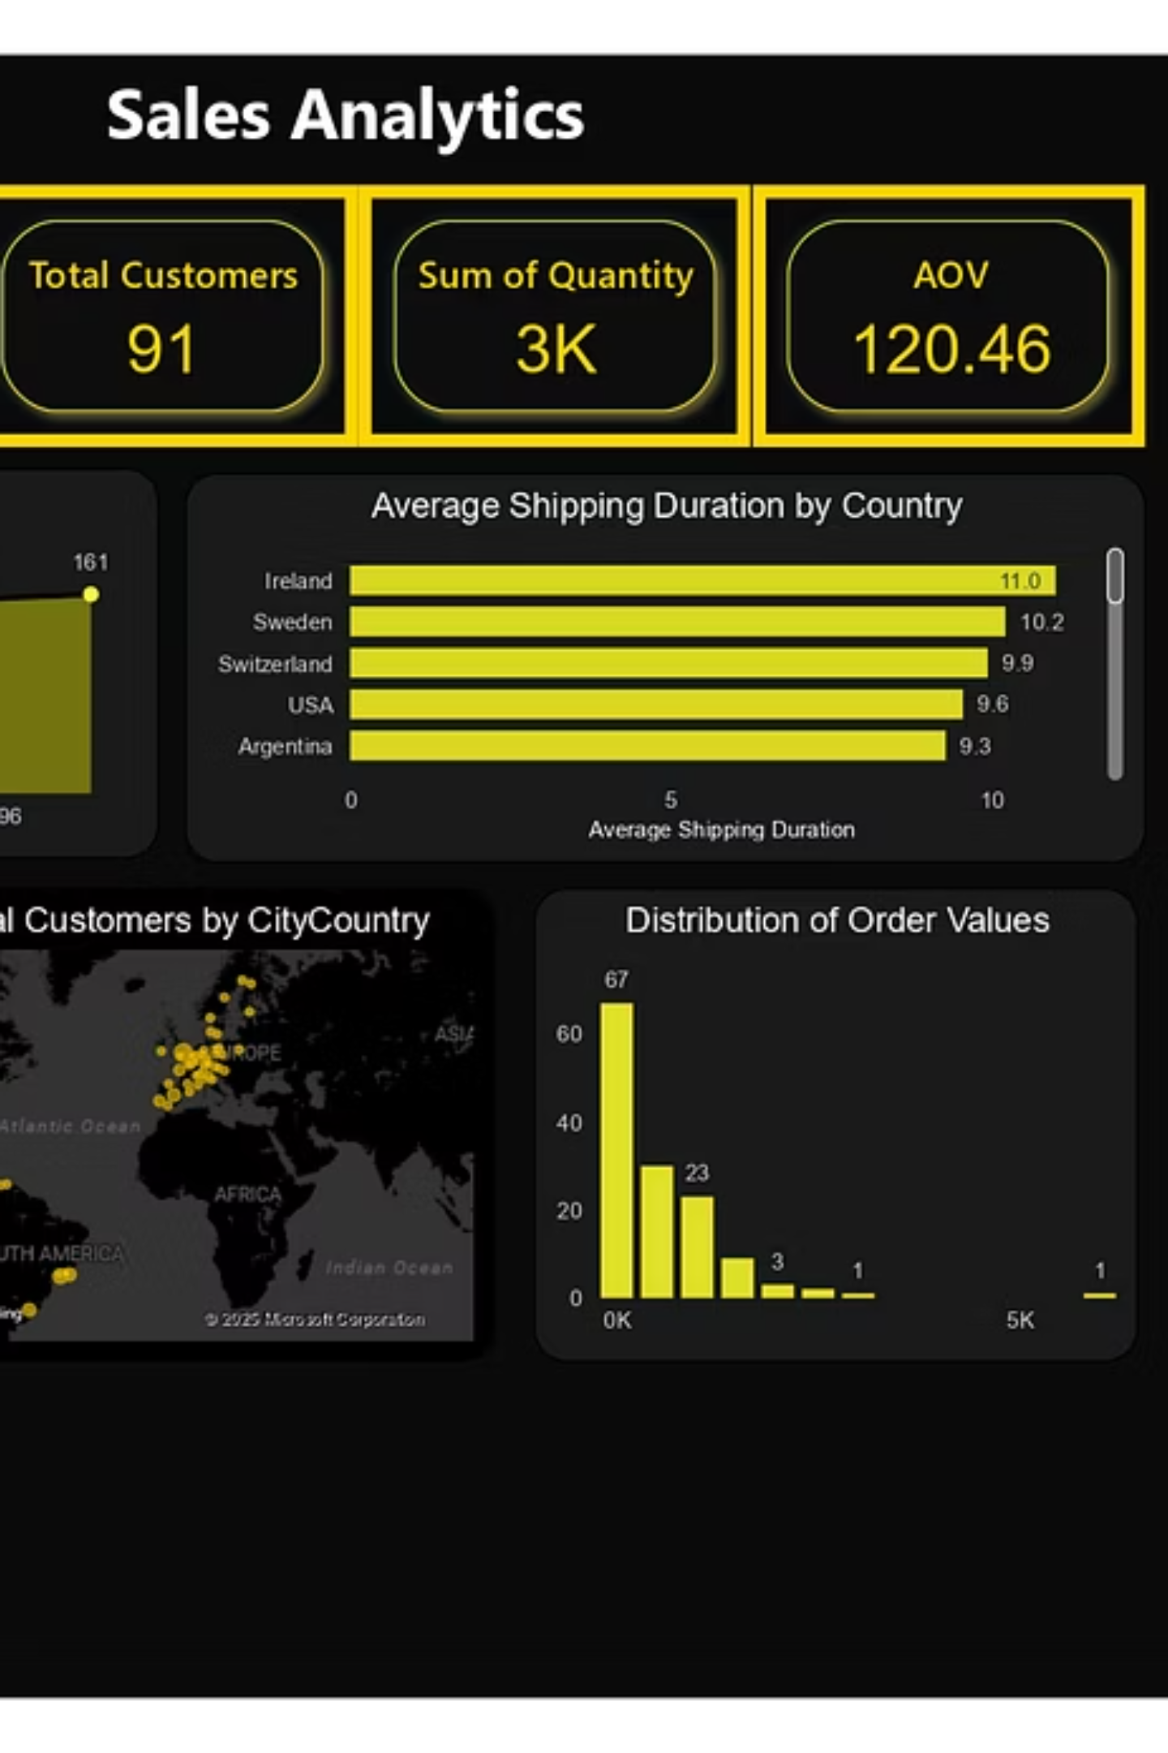



Dashboard Layout
KPIs
Middle Section
Revenue
Customer Orders Trend Over Time (Line Chart)
Count of Orders
Total Customers
Average Shipping Duration by Country (Bar Chart)
Sum of Quantity
AOV (Average Order Value)
Bottom Section
Customer Distribution by Contact Title (Pie Chart)
Total Customers by City/Country (Map Chart)
Distribution of Order Values (Histogram)

Slide 6
Key KPIs
Key Performance Indicators are displayed using Card visuals for emphasis.
1
2
3
Revenue
Total Orders
Total Customers
(Sales Amount)
4
5
Quantity Sold
Average Order Value
(AOV)

Slide 7
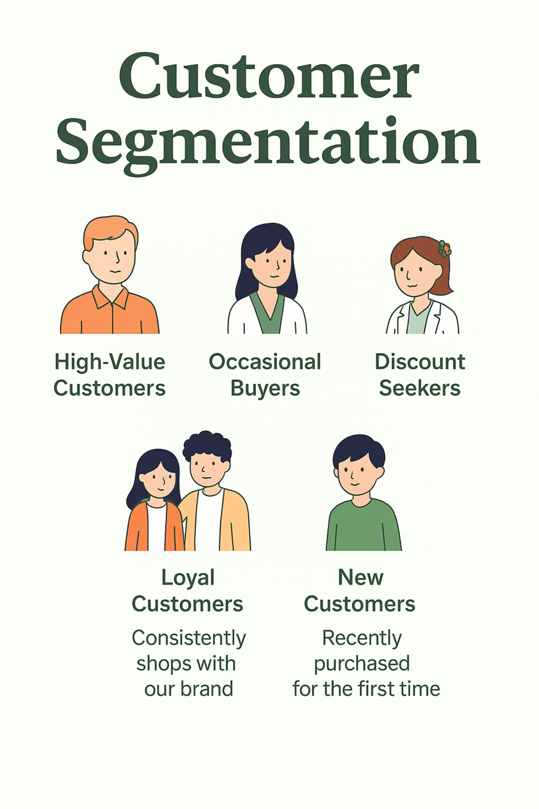



Customer Insights
Insights help identify high-value regions and customer segments.
Customer Distribution
Order Trends
Customer orders trend over time (Line chart).
Across countries/cities (Map + Bubble size).
Distribution by Title & Region
By Contact Title and Region (Pie chart).

Slide 8
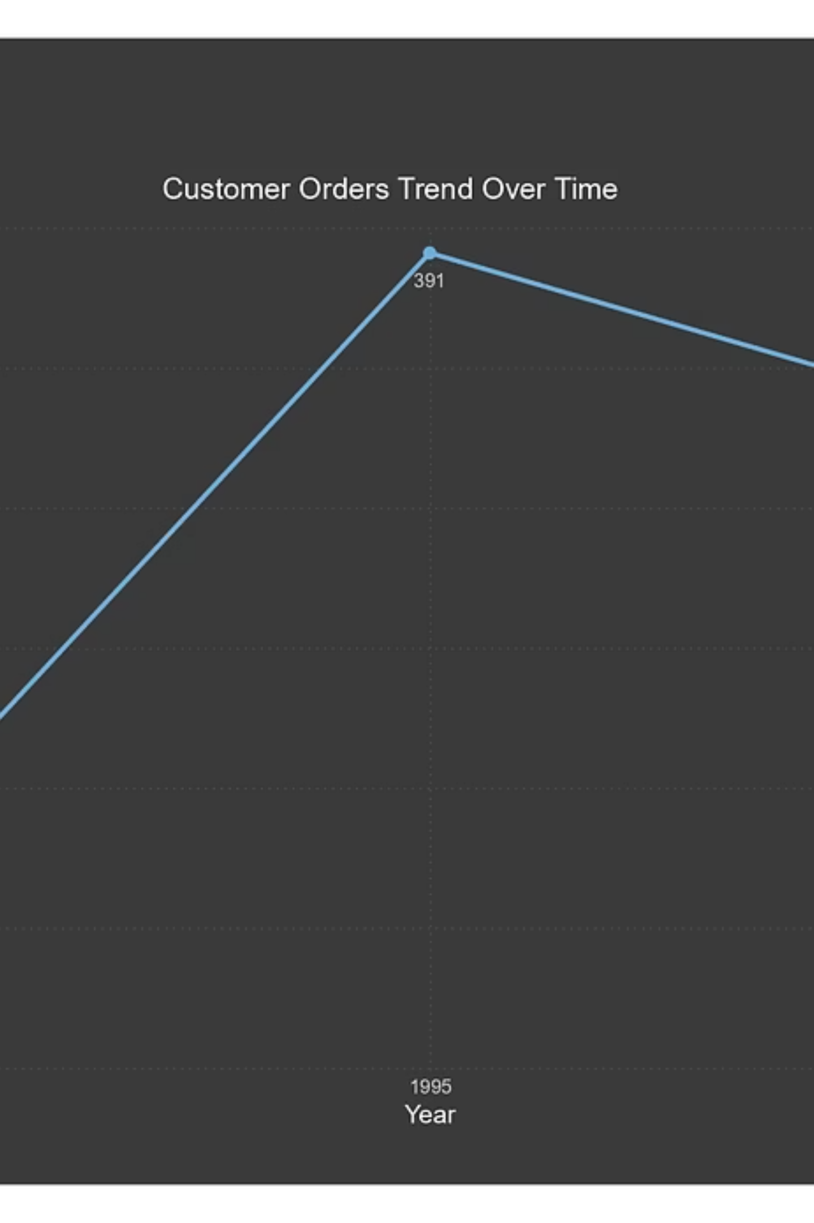



Order Analysis
Analyzing order frequency, value distribution, and shipping efficiency trends.
Order Volume
Change over time (Line or Column chart).
Order Values
Distribution of order values (Histogram).
Shipping Duration
Average by region (Bar chart).

Slide 9
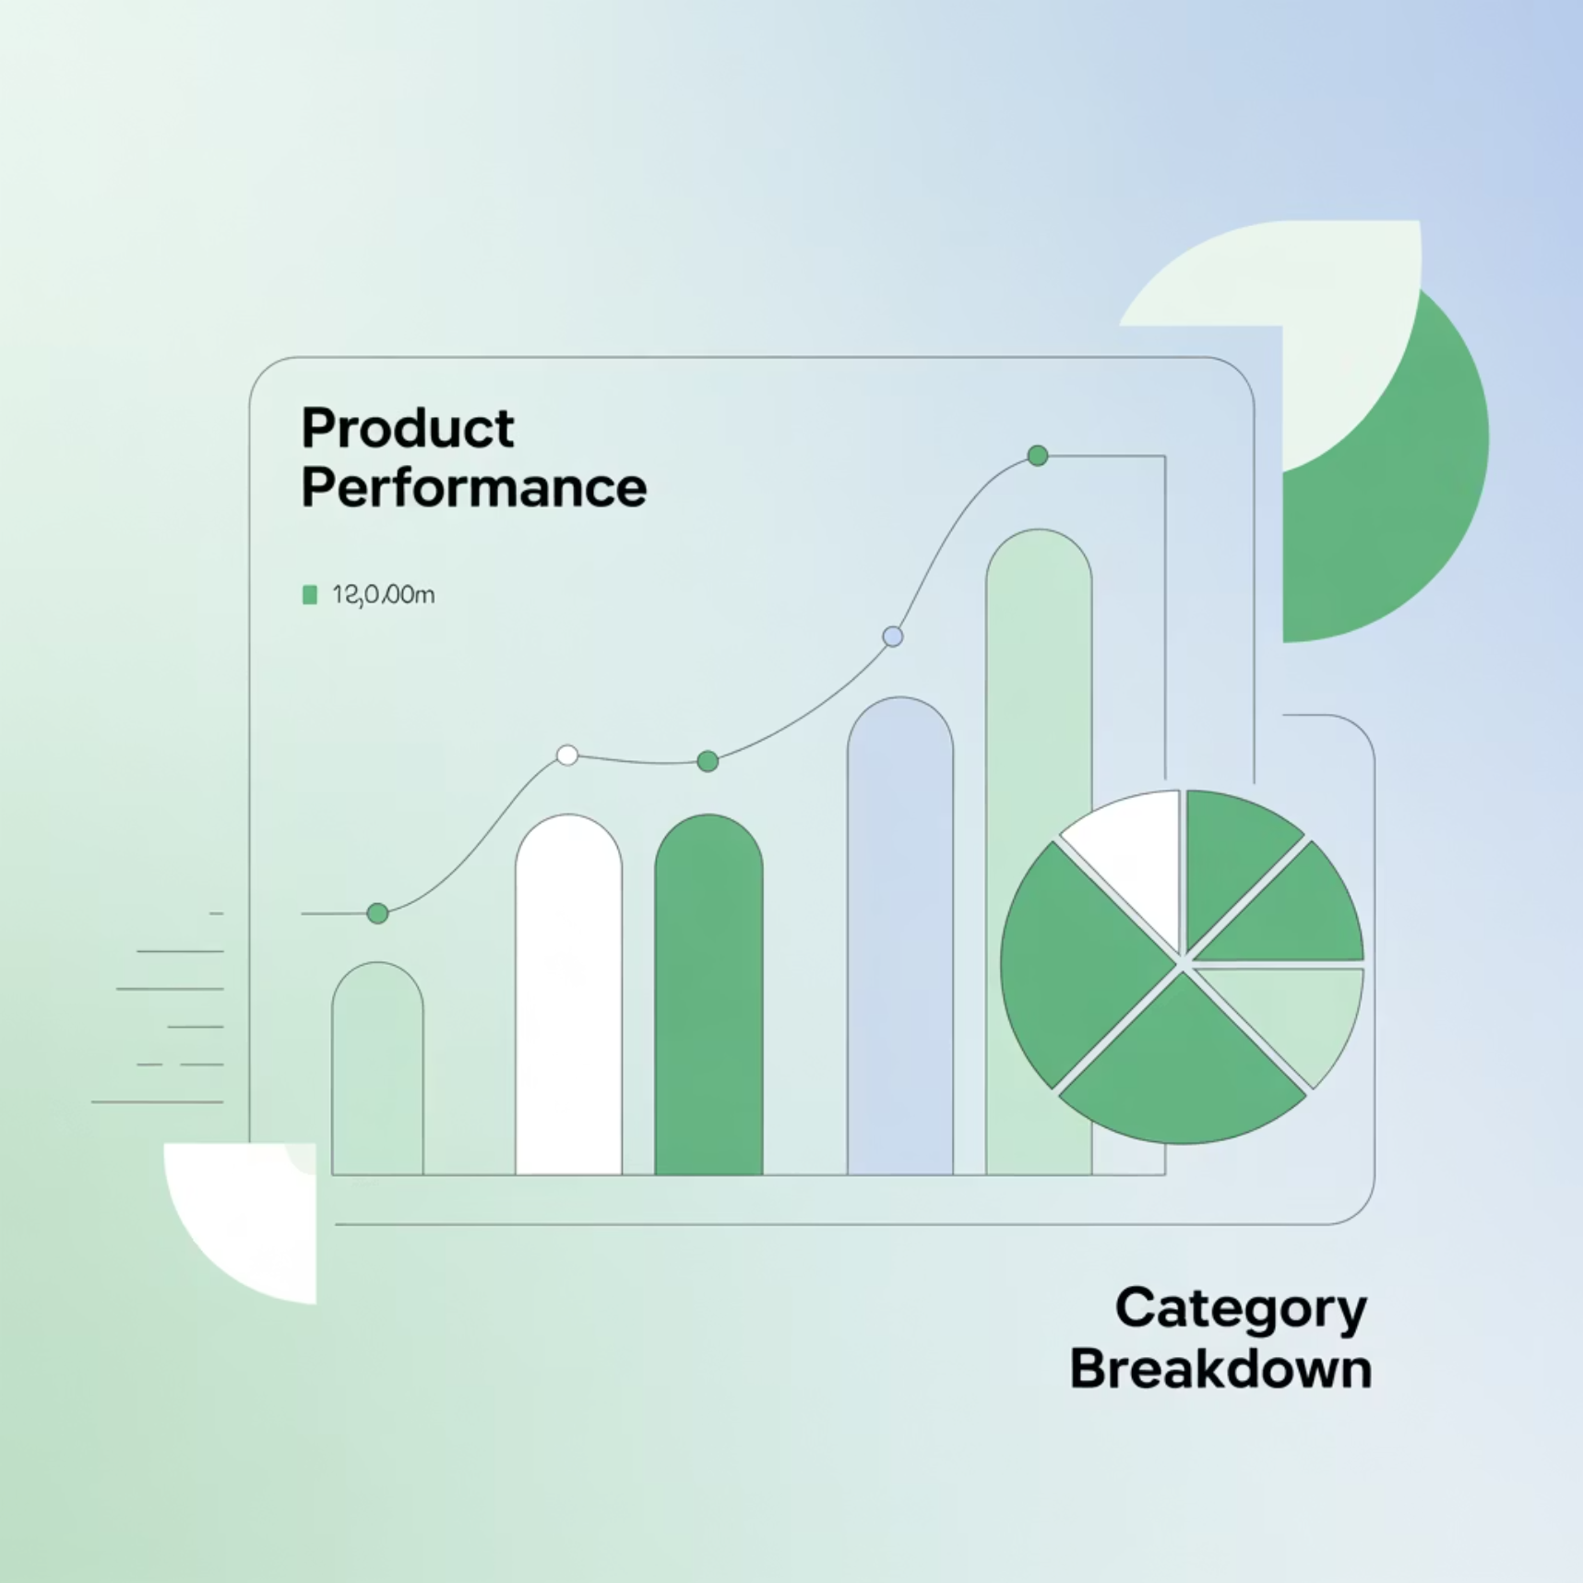

Product Performance Analytics
Top Performers
Best-selling product identification
Category-based sales analysis
Pricing distribution patterns
Supplier pricing variations
Key insight: Few products drive majority of sales while pricing varies significantly across suppliers

Slide 10







Supplier Analysis
Geographic Spread
Map visualization of supplier locations worldwide
Product Distribution
Number of products per supplier tracked via bar charts
Regional Pricing
Stacked charts showing pricing variations by region
Analysis reveals supplier concentration patterns and regional pricing strategies for strategic sourcing decisions.

Slide 11

Employee Workforce Insights
1
Job Title Distribution
Treemap visualization showing employee count by role
2
Tenure Analysis
Histogram displaying employee service duration patterns
3
Organizational Structure
Hierarchical tree mapping reporting relationships

Slide 12




Employee Analysis
1
Leadership
2
Management
3
Sales Team
4
Support Staff
Employee count by job title using treemap visualization. Tenure distribution histogram shows workforce experience levels.

Slide 13

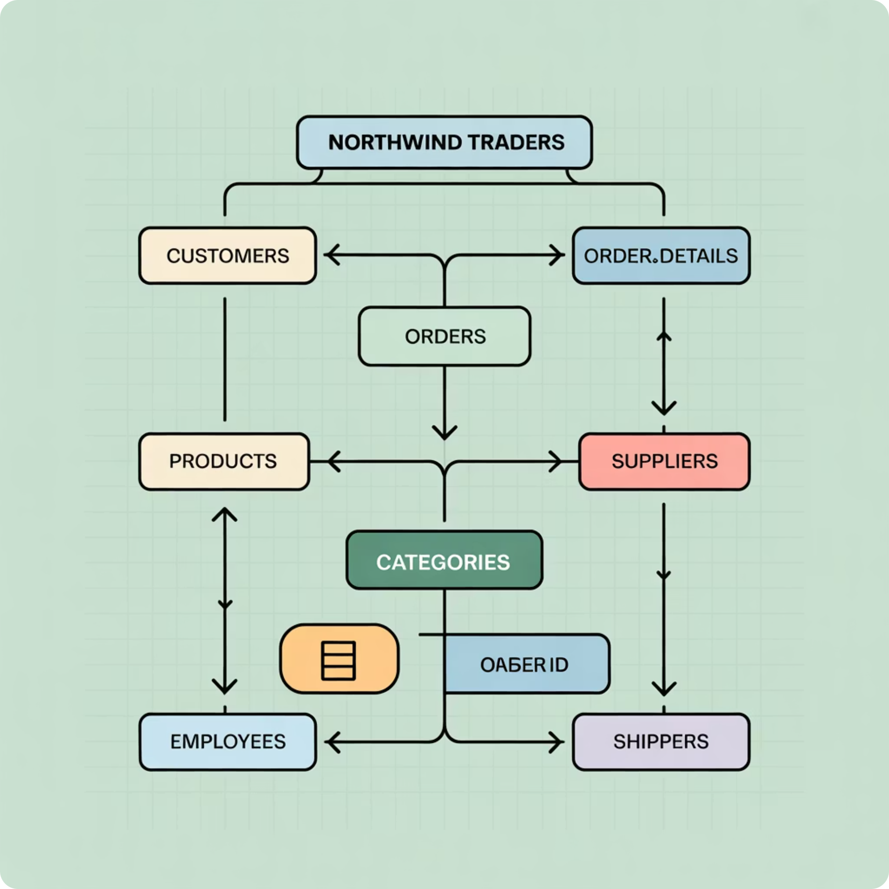
Entity Relationship Diagram
Entity-Relationship
Visual Documentation
Diagram(ERD)
Shows relationships between Customers, Orders, Products, Suppliers, Employees, and Shippers
An ERD is a visual representation of a database structure.It shows the entities (tables), their attributes (columns), and the relationships between them.
Technical Reference
Refer the ER image for complete data model understanding

Slide 14

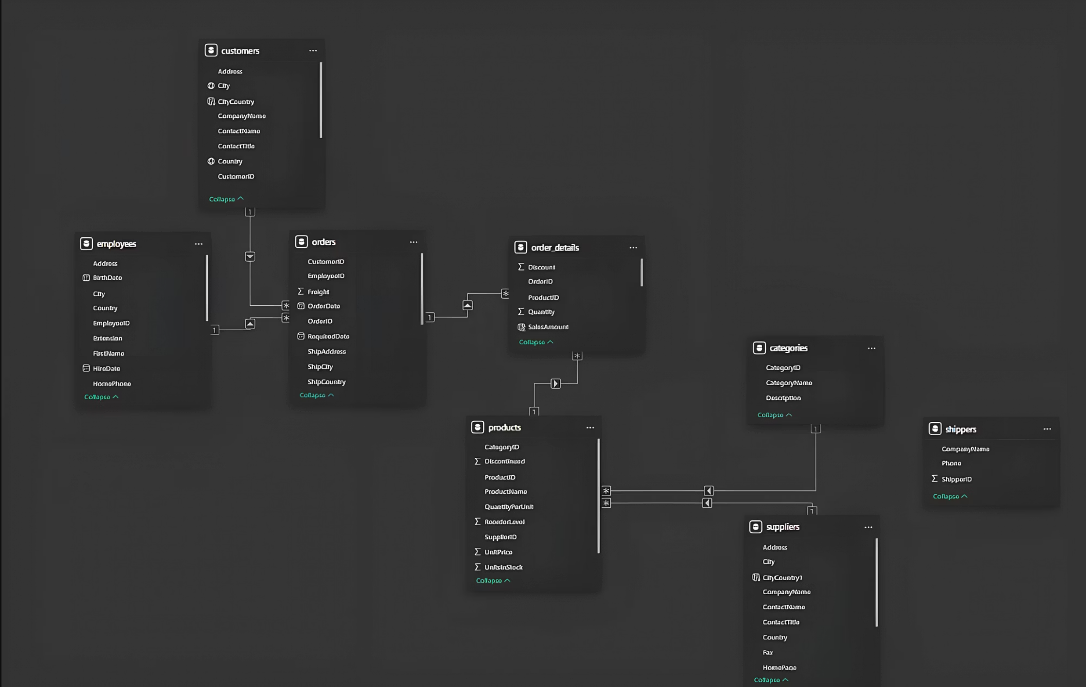

Slide 15
Key Findings & Strategic Insights
Customer Concentration
Seasonal Patterns
Product Dominance
Clear trends and shipping duration variations identified
Few products drive sales; pricing varies by supplier
High-value customers concentrated in specific countries
Geographic Strength
Organizational Clarity
Strong supplier base in Europe & USA regions
Clear reporting hierarchy with varying tenure

Slide 16





Project Impact & Value
The dashboard consolidates customer, product, supplier, and employee data to enable comprehensive data-driven decisions.
Sales Strategy
Supplier Management
Optimize based on insights
Improve vendor relationships
Performance Tracking
Monitor employee metrics
Overall impact: Competitive advantage in wholesale market through data intelligence

Slide 17

Thank You
Questions & Discussion
Contact: 8519862032
Email: akhil2002boddu@gmail.com

